Slide 1
Wastewater treatment: current approaches and prospects for sustainable solutions
CEE6580

Slide 2
Learning Objectives, Wastewater treatment and Waste-to-Energy
Recognize the various embedded energy in domestic wastewater (heat, nutrients, and organic carbon) and that most of the COD, and nutrients come from excreta (urine and feces)
Describe the elements of a functioning centralized sanitation system (User Interface, conveyance, centralized treatment system, disposal and/or reuse of treatment products)
Recognize sanitation options that don’t rely on centralized treatment (e.g. composting toilets, urine diverting dehydrating toilets, septic systems, constructed wetlands, biogas reactors)
Sketch out a typical US wastewater treatment plant and recognize the two greatest electricity demands (aeration of activated sludge and pumps to move wastewater)
Recognize the key benefits of of anaerobic digestion of wastewater organic matter to “biogas” (sludge reduction, production of useable biofuel, opportunity for co-digestion of wastewater organics with local food industry wastes (e.g. brewery wastes, food scraps, manure, cheese and yogurt whey)
Describe the overall biological conversions and key microorganisms for the following emerging/advanced biological treatment reactors
UASBs, EBPR, Anammox, GSBR, MEC/MFC, Anaerobic membrane bioreactors (MBRs), algal ponds
Describe the following chemical treatment to recover nutrients from wastewater
Struvite precipitation and ammonia stripping

Slide 3
Upcoming…
Exam is scheduled for 4/17. Will cover learning objectives up through Wastewater treatment and Waste-to-energy
Final Project: be deciding on your topic over break
Can be done individually or in groups up to 3 people
Final presentation will be 8-10 minutes per person
Must include reference to at least 4 publications (papers/chapters/reports) per person.
Presentations will be held in class May 1, 3 & 8.

Slide 4

Sustainable Sanitation and Water Management
www.sswm.org – run by EAWAG In Switzerland
Excellent technical resources and educational materials
We will explore website esp the pages on Water/nutrient cycles:
https://sswm.info/perspective/water-nutrient-cycle-perspective

Slide 5
Suggestions for session today:
Start a word or powerpoint document (or googledoc,etc).
Copy and paste images of websites screenshots as you go today.

Slide 6
What is Water Used For?
Domestic
Drinking water
Food preparation
Sanitation
Personal hygiene
Cultural asset
Gardening, Car wash
Industrial
Production of goods and energy
Transportation of goods
Process water
Agricultural
Irrigation
Livestock farming
HUMAN USE
Plants
Photosynthesis
ECOSYSTEM
Animals
Aquatic Systems
Soils

Slide 7
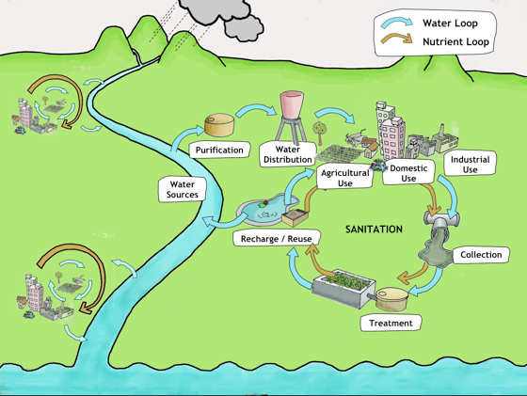

Slide 8
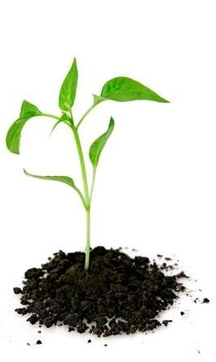
Nutrients
Nutrients are chemicals that all organism need to live and grow.
95 – 98% of living matter consists of C, H, O (MAHENDRAPPA 2007)
Although only needed in small amounts, macro- and micro- nutrients are essential for plant growth, blooming, photosynthesis, etc.
In relation to water manage- ment and sanitation, N and P are of high priority because of their high potential to cause eutrophication.
Nutrients
Non-mineral
Carbon (C)
Hydrogen (H)
Oxygen (O)
Macronutrients
Nitrogen (N)
Phosphorus (P)
Potassium (K)
Sulphur (S)
Magnesium (Mg)
Calcium (Ca)
Micronutrients
Various others
Adapted from: R. GENSCH (2010)

Slide 9
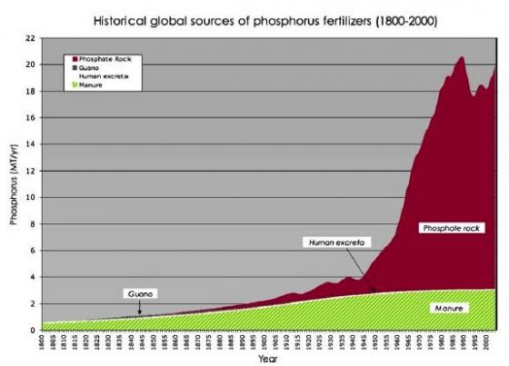
Peak Phosphorus?!
http://www.sswm.info/sites/default/files/toolbox/CORDELL%20et%20al%202009%20Sources%20of%20Phosphorus%20Fertilisers_large.jpg

Slide 10
There are three main reasons that lead to today’s situation of unsustainable management of water and nutrients:
Sectoral thinking
Unsustainable conventional approaches
Linear approaches to water and nutrient management

Slide 11
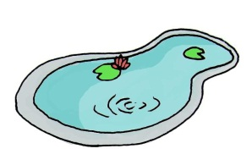
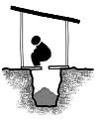
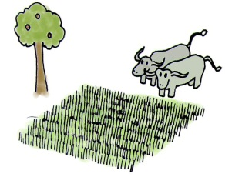


So, let’s link the water cycle, the nutrient cycle and sanitation AND ENERGY…
Energy
Water
Sanitation
Energy
Agriculture
… and solve three (four) big problems in one go!
Source: Own Graph

Slide 12
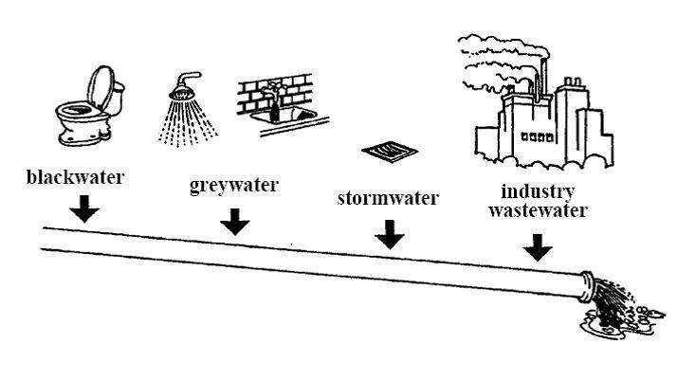
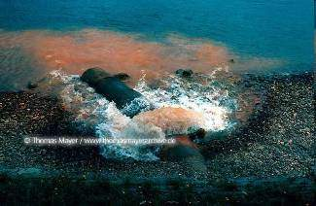
What is going wrong?
(2) Unsustainable current approaches: Mixing what shouldn’t be mixed..
With conventional waterborne flush-toilets, we mix
roughly 50 kg of faecal matter (per person/year)
50 kg
roughly 500 l of urine (per person/year)
500 L
with roughly 20’000l of clean flushwater*
20’000 L
If this wastewater is discharged untreated into rivers, an even higher amount of water is polluted!
http://thomasmayerarchive.de
*Based on an average for a toilet that uses about 8 L of Water per flush (11).
Notes:
12
This is a figure based on the Swiss average, for a toilet that uses about 8 L of Water per flush. However, toilets (mainly in North America) can use up to 5 Gallons (roughly 23l) just for one flush! This would add up to a water use (just for flushing!!) of almost 50’000 l per person and year – and the fact that the polluting substances make up just 1 % of the total wastewater!

Slide 13
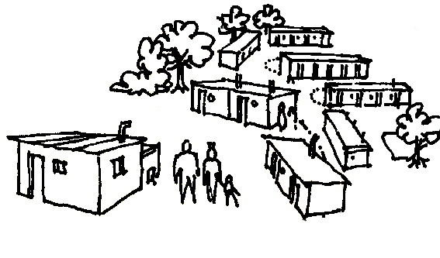
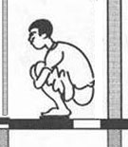
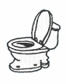
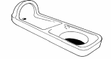
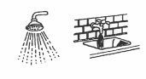
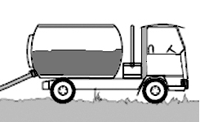
What products are we dealing with?
Introduction
Excreta: urine & faeces
Blackwater: urine, faeces & flush
Yellow-water:
separated urine
Greywater: wastewater from kitchen, bath, shower.
Faecal sludge: solids and liquids accumulating in sanitation systems
A sanitation system must manage all products generated !
Notes:
Key messages
Households produce different waste products.
A sanitation system must deal with all products generated.
Next slide: What are the characteristics of waste products?
Additional information & questions:
The generation of liquid waste from human activities is unavoidable. However, not all humans produce the same amount of liquid waste. The type and amount of liquid waste produced in households is influenced by behaviour, lifestyle and standard of living of the population as well as by the governing technical and juridical framework. (Henze and Ledin 2001, pp. 57-72)
The following section describes the different liquid waste fractions produced by the households. Industrial wastewater is not included, although it makes up an important fraction of wastewater in some environments. (Tilley 2007, pp. 2)
Blackwater is the mixture of urine, faeces and flushing water, along with anal cleansing water (if anal cleansing is practiced) or dry cleansing material (e.g. toilet paper).
Greywater is used water which results from bathing, hand-washing, cooking or clothes-washing. It is sometimes mixed with, or treated along with, other types of products
Urine is urine that is not mixed with any faeces or water.
Faeces refers to (semi) solid excrement without any urine or water.
Excreta is the mixture of urine and faeces that is not mixed with any flushing water (although small amounts of anal cleansing water may be included).
Faecal Sludge is the general term for the undigested, or partially digested slurry or solid that results from the storage or treatment of blackwater or excreta.
Why distinguish between so many products?

Slide 14
Characteristics of waste products
Introduction
 | Total | Greywater*** | Urine | Faeces
Volume [l/cap·yr] | 25’000-100’000 | 25’000-100’000 | 500 | 50
Nutrients Nitrogen | 2 - 4 kg/cap·yr | 5% | 85% | 10%
Phosphorous | 0.3 - 0.8 kg/cap·yr | 10%** | 60% | 30%
Potassium | 1.4 - 2.0 kg/cap·yr | 34% | 54% | 12%
COD (organic material) | 30kg/cap·yr | 41% | 12% | 47%
Faecal coliforms | - | 10⁴-10⁶ /100ml | 0* | 10⁷-10⁹ /100ml
* healthy people
** can be as high as 50%, depending on washing and dish-washing powder used
*** values representative for industrialized countries
Notes:
Key messages:
Greywater, urine and faeces have distinct characteristics.
When dealing with waste products, it is important to account for their value and potential risks.
Next slide: Characteristics of waste products in words
Additional information & questions (also on next slide!):
Urine: Contains almost all the nitrogen and large parts of the potassium and phosphorous excreted by humans. N:P:K = 10:1:2 Urine is usually sterile (exceptions known by urinary tract infections).
Faeces: Mainly undigested organic matter made up of carbon. Faeces contain almost all pathogens:
bacteria (e.g. faecal coliforms, vibro cholerae)
viruses (e.g. rota virus)
protozoa (e.g. amoeba hystolitica)
helminths (e.g. Ascaris eggs)
Low nutrient content, but good characteristics as soil conditioner
Greywater:
Greywater is defined as household wastewater without input of human excreta
It includes used water from baths, showers, hand basins, washing machines, dishwashers, laundries and kitchen sinks
Big quantities with relatively low nutrient contents.
Big reuse potential:
Irrigation: Agriculture, landscape, aquaculture
Municipal uses: Fire protection, street cleaning, car washing, cooling, road construction operation, ...
Non-potable domestic uses: Toilet flushing, laundry, floor cleaning
Main issue: Toxic substances (organic compounds, metals, chlorine etc.), fats from kitchen, can affect natural treatment and disposal systems
Which constituents cannot be removed from waste products by most treatment technologies? How can that problem be solved?
Why is the volume an important parameter for describing waste products?
Are the nutrients in faeces readily available?

Slide 15
Characteristics of waste products
Introduction
 | Greywater | Urine | Faeces
Chemical contamination | Fats, oils and toxic substances org. compounds, chlorides, metals | Micro-contaminants e.g. hormons & antibiotics | Micro-contaminants e.g. Heavy metals
Biological contamination | Pathogens bacterias, viruses, helminths, protozoa | Almost sterile i.e. cross-contamination from feaces | Pathogens bacterias, viruses, helminths, protozoa
Value | Reuse potential for irrigation or municipal and non-potable domestic use | Nutrients (N, K and P etc.) => ideal fertilizer | Good soil conditioner, but only little nutrients
Notes:
Key message:
When dealing with waste products, it is important to account for their value and potential risks.
Next slide: What are the processes of sanitation systems?
Additional information & questions:
Potential reuse applications could be:
Greywater should be reused for irrigation, washing, etc.
Urine is a perfect fertilizer
Faeces are very good soil conditioner (after treatment)
=> The sanitation products are valuable!
Which constituents cannot be removed from waste products by most treatment technologies? How can that problem be solved?
Why is the volume an important parameter for describing waste products?
Are the nutrients in faeces readily available?
How can eutrophication of a lake be reversed?
How can future generations meet their phosphorus demand?

Slide 16
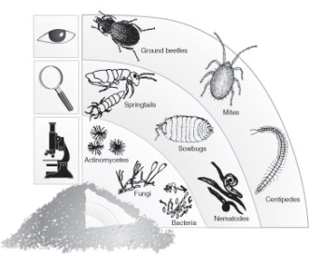
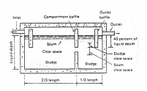
Sanitation: What are the Functional Groups through which the products flow?
Systems and Technologies
Technologies which perform the same, or similar function, are grouped into „Functional Groups“
User Interface
Use
and/or Disposal
Collection
and Storage/ Treatment
(Semi-)
Centralised
Treatment
Conveyance
e.g. Dry Toilet or Pour Flush Toilet
e.g. Composting
or Leaching Field
e.g. Anaerobic
Baffled Reactor
or Waste Stabilisation
Pond
e.g. Septic
Tank
e.g. Simplified
Sewer or
Tank Lorries
Input products
safe & valuable output products
Notes:
Key messages:
A sanitation system is a combination of technologies through which the products flow.
Technologies which perform the same, or similar function, are grouped into „Functional Groups“
Next slide: How can the Functional Groups be linked?
Additional information & questions:
User interface describes the type of toilet, pedestal, pan or urinal the user comes in contact with. User interface also determines the final composition of the product, as it is the place where water is introduced in the system. Thus, the choice of user interface is often dependent on the availability of water.
Collection and storage/treatment describes the ways of collecting and storing products generated at the user interface; storage often also performs some level of treatment.
Conveyance describes the way in which products are moved from one process to another. Although products may need to be moved in various ways to reach the required process, the longest and most important gap lies between on-site storage and (semi-) centralised treatment. For the sake of simplicity, conveyance is thus limited to moving products at this point.
(Semi-) centralised treatment refers to the treatment systems which, unlike those used on-site, are larger, require a greater inflow (that can usually not be met by just one family) and often more skilled operation.
Reuse and disposal refers to the ways in which products are ultimately returned to the soil, either as harmless substances or useful resources. Furthermore, products can also be re-introduced into the system as new products. A typical example is the use of partially treated greywater used for toilet flushing.
Which processes are not required in certain sanitation systems?

Slide 17

Which technologies can perform which function?
Systems and Technologies
User Interface
Collection
and Storage/ Treatment
Conveyance
(Semi-)
Centralised
Treatment
Use and/or
Disposal
Dry Toilet
Urine Diverting Dry Toilet
Urinal
Pour-Flush Toilet
Flush Toilet
Urine Diverting Flush Toilet
Single Pit
Single VIP
Dehydration Vaults
Septic Tank
Composting Chamber
Anaerobic Baffled Reactor
Anaerobic Filter
etc.
Human-Powered Emptying and Transport
Motorized Emptying and Transport
Simplified Sewers
Small-Bore Sewer
Conventional Gravity Sewer
Jerry Can/Tank
etc.
Anaerobic Baffled Reactor
Anaerobic Filter
Upflow Anaerobic Sludge Blanket
Trickling Filter
Waste Stabilisation Ponds
Activated Sludge
Constructed Wetland
Co-composting
etc.
Application of Urine
Application of Dehydr. Faeces
Compost
Irrigation
Aquaculture
Soak Pit
Leach Field
Land Application
Surface Disposal
etc.
Only selected combinations of technologies will lead to functional systems.
Notes:
Key messages:
Only selected combinations of technologies will lead to functional systems.
The most site-specific system option has to be selected on a case-to-case basis.
Note: in some systems, not all processes are required. Eg. When composting faeces locally, no conveyance nor central treatment is required.
Next slide: How can sanitation systems be classified?
Additional information & questions:
A system is a set of technologies, each processing the products until they are ultimately disposed of. In other words, processing all the waste products “from cradle to grave” should be considered. As aforementioned, one can distinguish between eight mainly different treatment systems whose technologies can be logically linked to form an effective system.
Though the system templates (i.e. groups of processes and products) are predefined, the exact system and favoured technology still have to be selected from among the options provided. The choice is context-specific and should be made on the basis of the local environment, culture and resources. Despite the different technology options available, a comprehensive study of the specific situation is necessary prior to making the final decision.
Who should choose the technology options and based on what criteria?

Slide 18
Which technologies can perform which function?
Systems and Technologies
User Interface
Collection
and Storage/ Treatment
Conveyance
(Semi-)
Centralised
Treatment
Use and/or
Disposal
Dry Toilet
Urine Diverting Dry Toilet
Urinal
Pour-Flush Toilet
Flush Toilet
Urine Diverting Flush Toilet
Single Pit
Single VIP
Dehydration Vaults
Septic Tank
Composting Chamber
Anaerobic Baffled Reactor
Anaerobic Filter
etc.
Human-Powered Emptying and Transport
Motorized Emptying and Transport
Simplified Sewers
Small-Bore Sewer
Conventional Gravity Sewer
Jerry Can/Tank
etc.
Anaerobic Baffled Reactor
Anaerobic Filter
Upflow Anaerobic Sludge Blanket
Trickling Filter
Waste Stabilisation Ponds
Activated Sludge
Constructed Wetland
Co-composting
etc.
Application of Urine
Application of Dehydr. Faeces
Compost
Irrigation
Aquaculture
Soak Pit
Leach Field
Land Application
Surface Disposal
etc.
Only selected combinations of technologies will lead to functional systems.
Notes:
Key messages:
Only selected combinations of technologies will lead to functional systems.
The most site-specific system option has to be selected on a case-to-case basis.
Note: in some systems, not all processes are required. Eg. When composting faeces locally, no conveyance nor central treatment is required.
Next slide: How can sanitation systems be classified?
Additional information & questions:
A system is a set of technologies, each processing the products until they are ultimately disposed of. In other words, processing all the waste products “from cradle to grave” should be considered. As aforementioned, one can distinguish between eight mainly different treatment systems whose technologies can be logically linked to form an effective system.
Though the system templates (i.e. groups of processes and products) are predefined, the exact system and favoured technology still have to be selected from among the options provided. The choice is context-specific and should be made on the basis of the local environment, culture and resources. Despite the different technology options available, a comprehensive study of the specific situation is necessary prior to making the final decision.
Who should choose the technology options and based on what criteria?

Slide 19
Methanogenesis in Anaer. Digesters

Slide 20
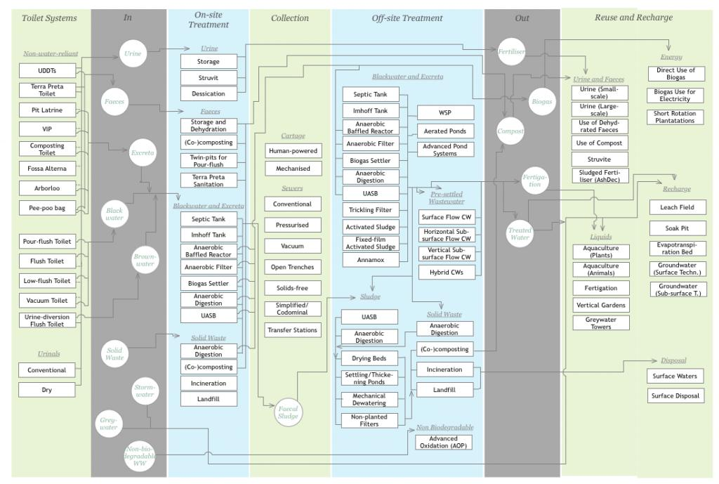

Slide 21
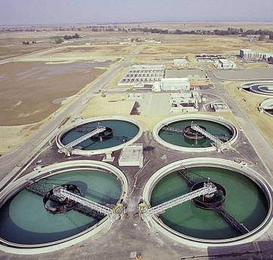
Current approaches in US: Example High-Tech Wastewater Treatment Plants
Which will need:
Long sewer network & pumps to get the wastewater to the plant
Electricity for aeration, pumps and other moving parts
Skilled (and thus expensive) operation & maintenance staff
High cost
Recycling difficult due to contamination of heavy metals, etc..
→ Who will pay for this?

Slide 22
Typical WW Trtmt Plant in the US (consumes average of 0.54kWhr/1000 L treated)
Biogas (CH4 and CO2)
Anaerobic Digester
Ithaca Area WWTP:
-6 million gallons of sewage per day.
-Tertiary treatment for P
Burns methane to provide 55% of plant Energy needs (electric and heat)
Biosolids (to landfills, currently)

Slide 23
Basic mass flows and processes in typical US WWTF
air
CO₂
Sewage
(raw WW)
Settling
Settling
Treated water
Aeration tank
Polishing
Anaer. Digester
Sludges
Biogas
Solids
Average electricity usage (wide range):
0.54 kWhr/cubic meter wastewater
(WW treatment is ~1-4 % of US electricity use

Slide 24
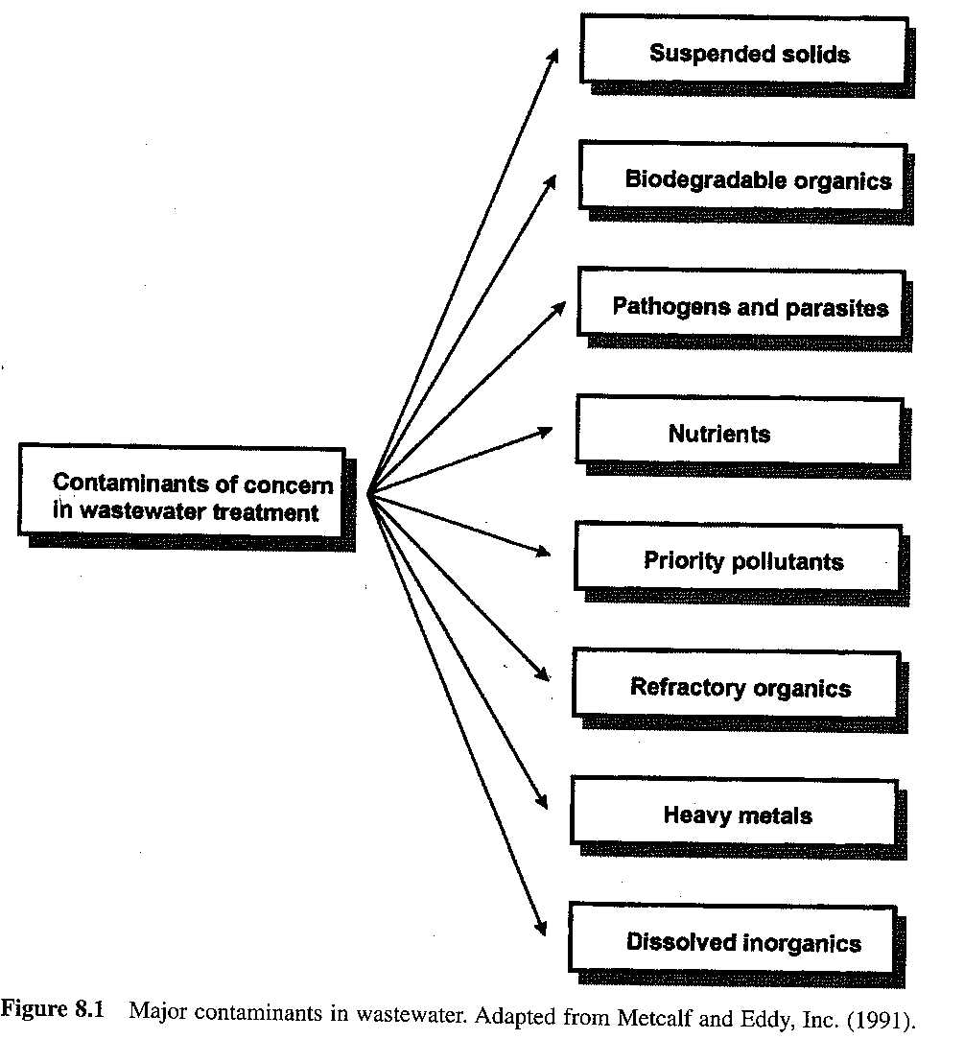
Notes:
Negative Effects? Human vs Ecological Health effects

Slide 25
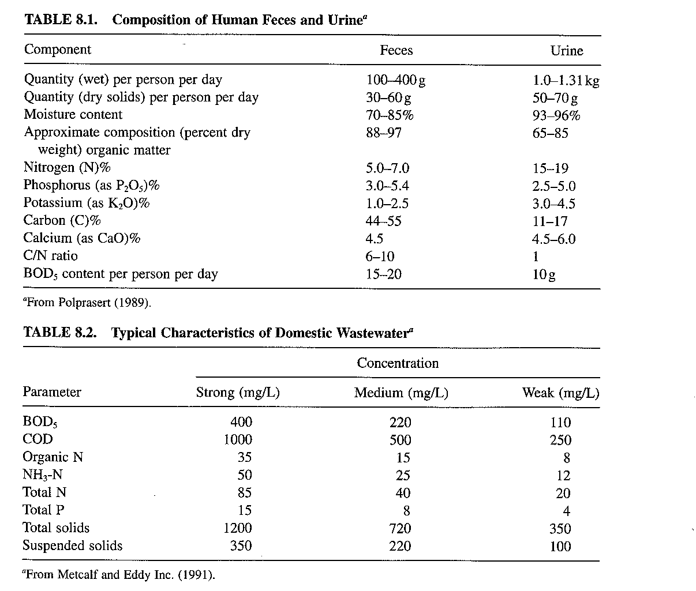

Slide 26
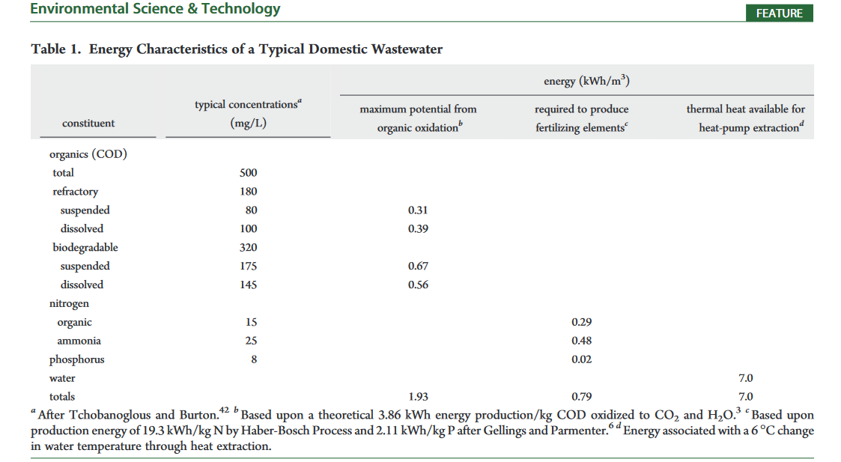
From McCarty, P.L., Bae, J., Kim, J., 2011. Domestic Wastewater Treatment as a Net Energy Producer–Can This be Achieved? Environmental Science & Technology 45, 7100–7106. https://doi.org/10.1021/es2014264

Slide 27
From McCarty, P.L., Bae, J., Kim, J., 2011. Domestic Wastewater Treatment as a Net Energy Producer–Can This be Achieved? Environmental Science & Technology 45, 7100–7106. https://doi.org/10.1021/es2014264

Slide 28
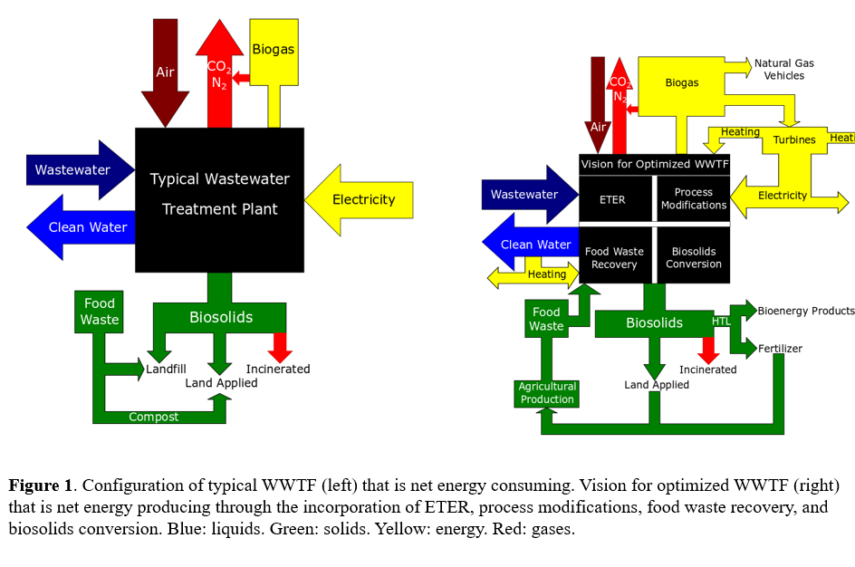
Status Quo (left) vs Vision (right) for US WWTFs (current proposal idea we are working on w/WW plant Ithaca)

Slide 29
Emerging Biotech for sustainable WW treatment
Anaerobic (or aerobic/anaerobic cycling) treatment
E.g. UASB, Anaerobic Membrane bioreactors
Granular SBRs
Anammox
Nutrient (N & P) removal/recovery
EBPR
Algal ponds
Chemical : ammonia stripping; Struvite (MgNH₄PO₄) precipitation

Slide 30
UASB

Slide 31
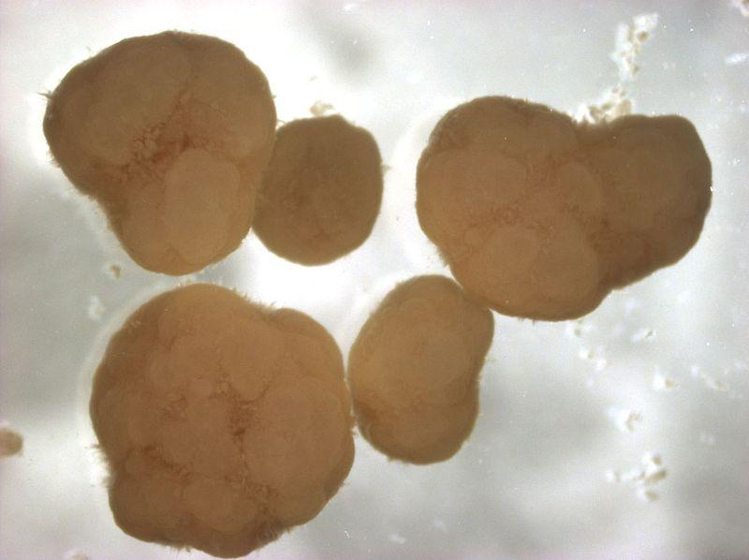
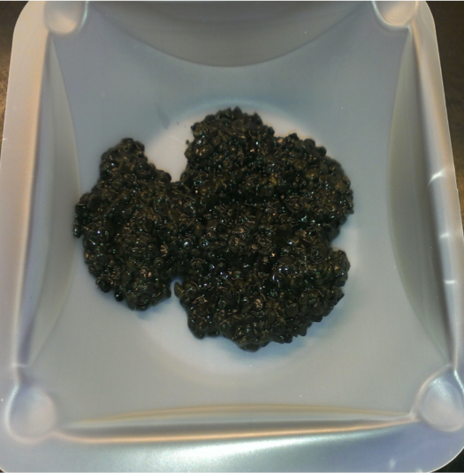
Granules

Slide 32
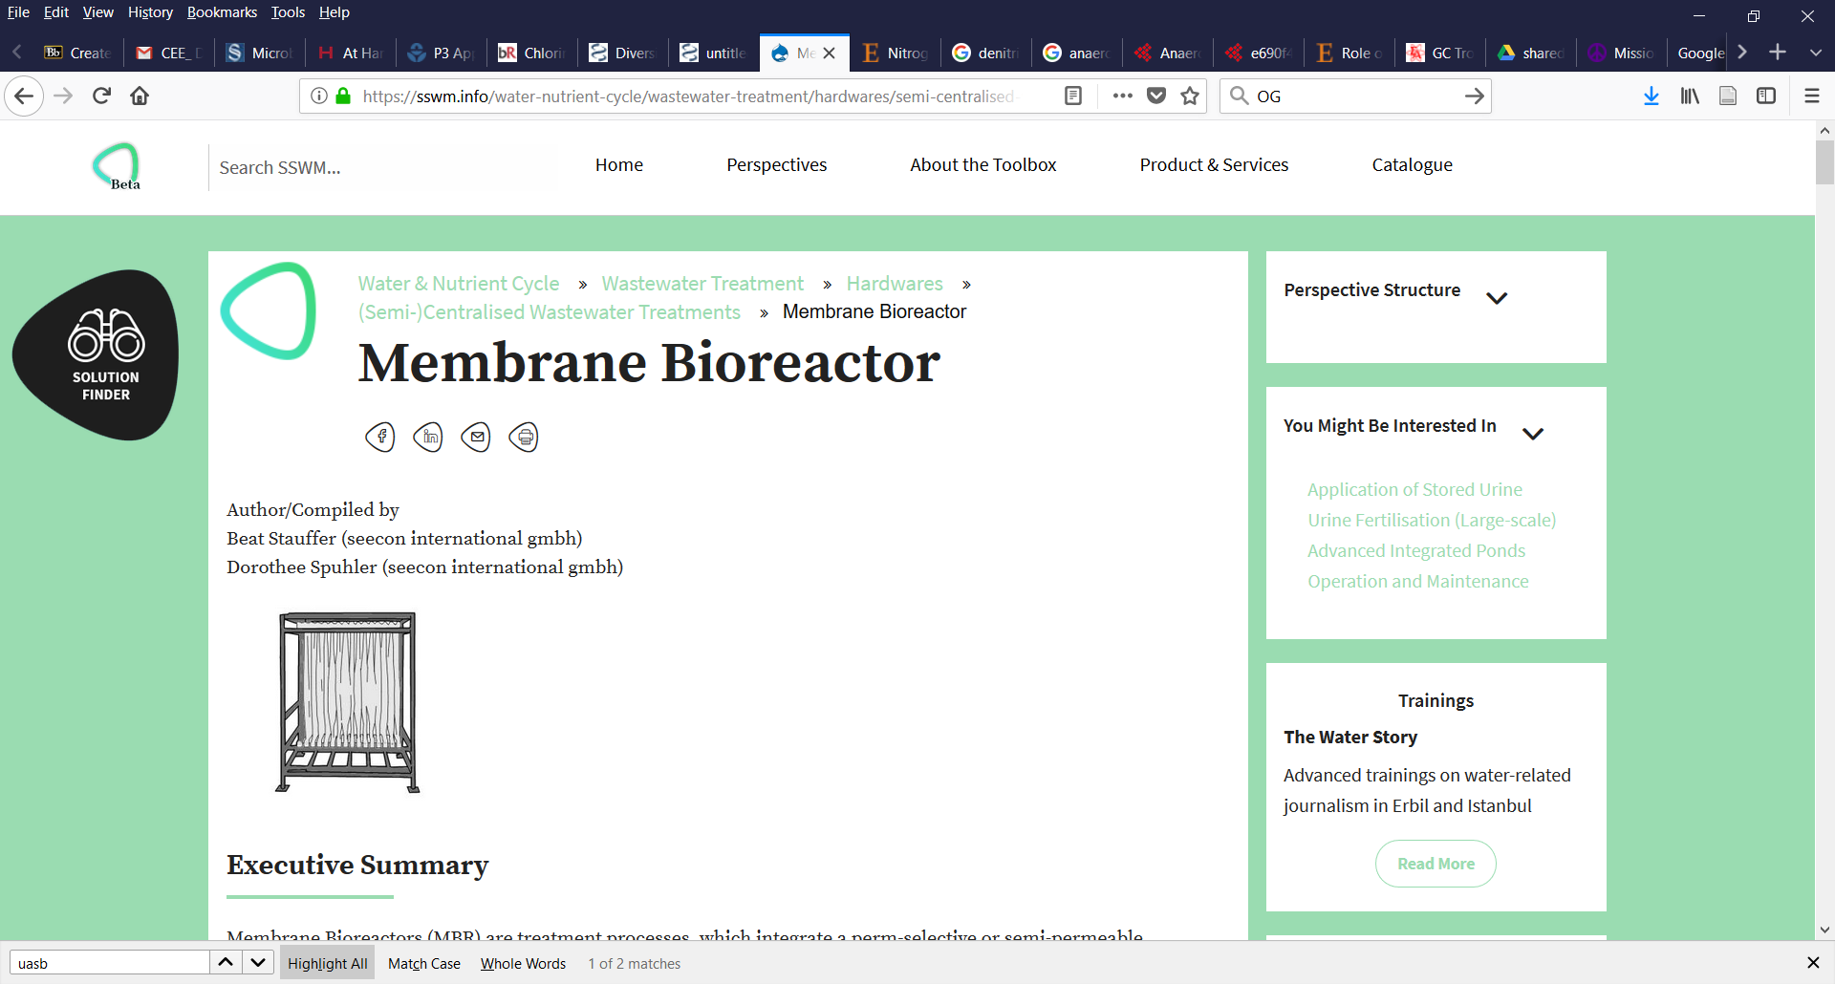
Membrane bioreactors
Membranes replace the need for a settling tank after a bioreactor
Can be used with either aerobic or anaerobic processes

Slide 33
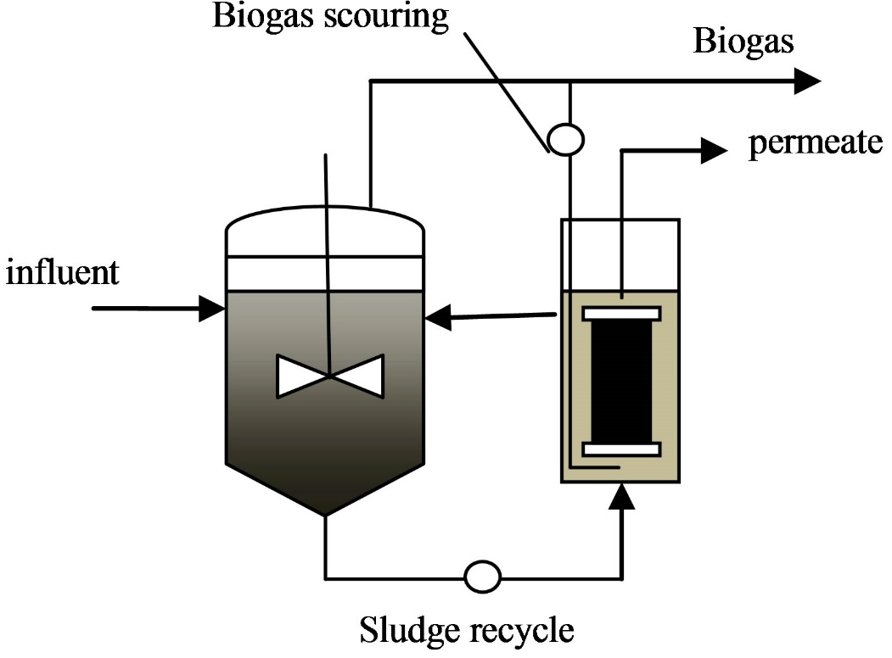
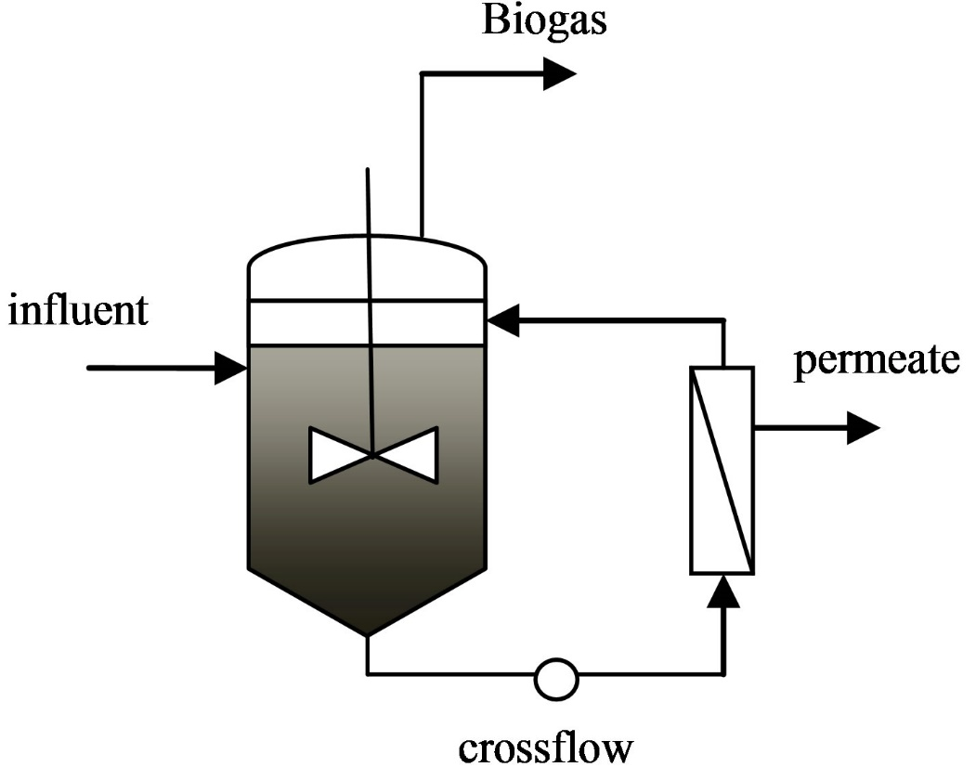
Anaerobic Membrane Bioreactor configurations

Slide 34
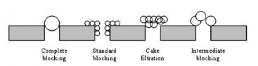
Major concerns with membranes
Energy costs (pressure to send water through)
Fouling

Slide 35
Nutrients N & P

Slide 36
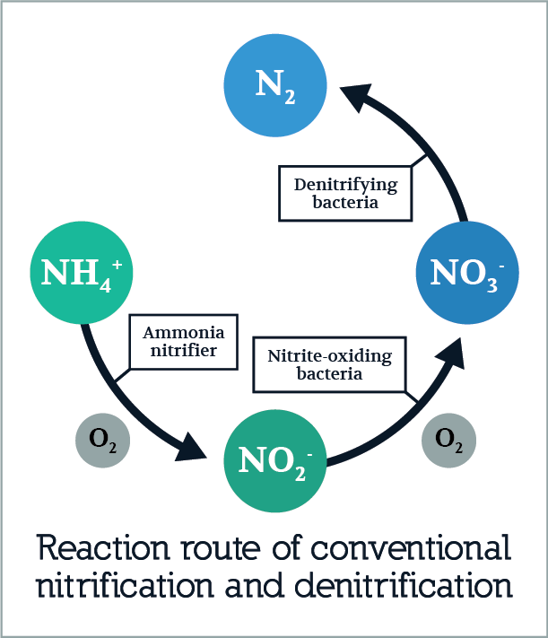
Nitrogen removal strategies
Nitrification/Denitrification
NH₃ + 2O₂ = NO₃⁻ + H⁺ + H₂O
NO₃⁻ + (5 e- + 6H⁺ )= ½ N₂ +3 H₂O
Partial nitrification/Anammox (= nitritation/anammox)
½ NH₃ + ¾ O₂ = ½ NO₂⁻ + ½ H⁺ + ½ H₂O
½ NH₃ + ½NO₂⁻ + ½ H⁺= ½ N₂ + H₂O

Slide 37
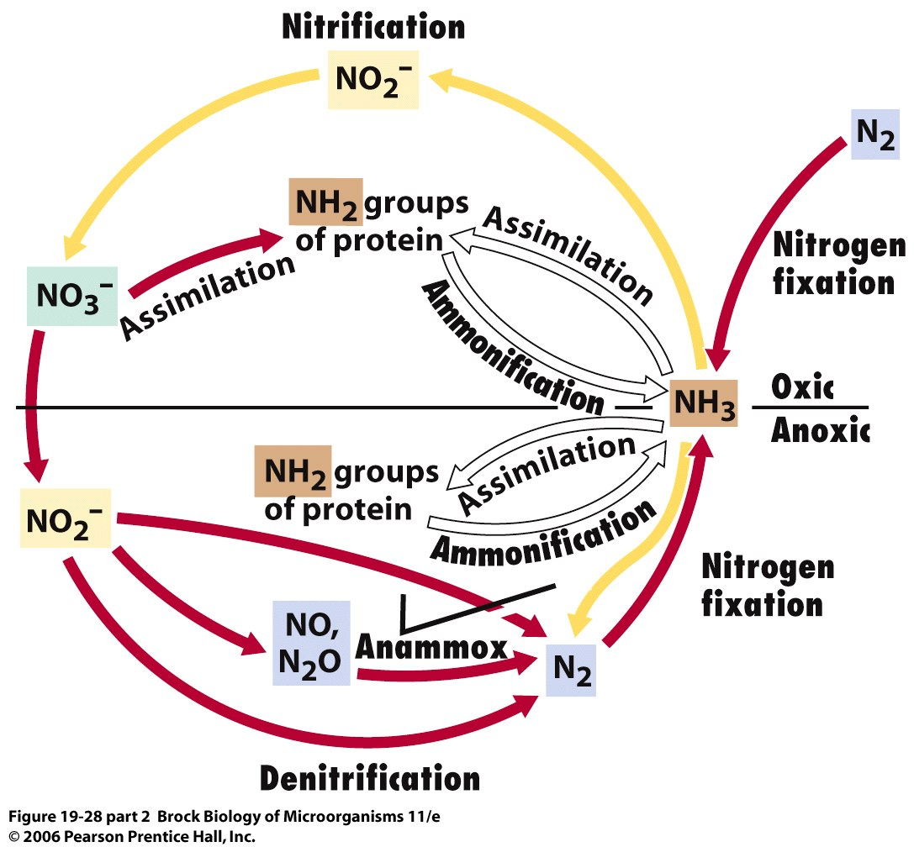
Reminder of the nitrogen cycle!
Notes:
Most of the nitrogen on earth is in the gaseous form, in N2
We’re going to start by focusing over here on nitrogen fixation. Very important because organisms need a useable form of nitrogen…

Slide 38
Nitrification/denitrification
Nitrification: aerobic process in which bacteria oxidize reduced forms of nitrogen
Denitrification: anaerobic process by which oxidized forms of nitrogen are reduced to gaseous forms, which can then escape into the atmosphere
Why is it important to remove these forms of nitrogen?
Notes:
This is important because the release of nitrogen to the aquatic environment can also cause eutrophication.
Denitrifiers play several roles — some positive, some negative — in wastewater
treatment processes. We exploit the activities of denitrifiers in biological
processes designed to remove nitrate from municipal or agricultural wastewaters.
On the other hand, if unwanted denitrification occurs in the bottom of settling
tanks, the resulting nitrogen gas bubbles can cause rising sludge problems (the
bubbles essentially lift floc particles off the bottom of the tank, lowering the
solids-separation efficiency). The key to preventing rising sludge problems is to
minimize the concentration of degradable carbon entering the settling tank and/or
minimize the residence time of solids in the sludge blanket at the bottom of the
tank. discharged into the environment, it can deplete the natural oxygen resources. Eutrophication is the process by which bodies of water become rich in mineral and organic nutrients causing plant life, especially algae, to proliferate, then die and decompose thereby reducing the dissolved oxygen content and often killing off other organisms. Wastewater treatment in the plants involve primary, secondary and tertiary treatment. Primary treatment deals with removing large solids while secondary treatment removes the smaller solids and tertiary treatment involves the disinfection of the wastewater through chemical means.

Slide 39
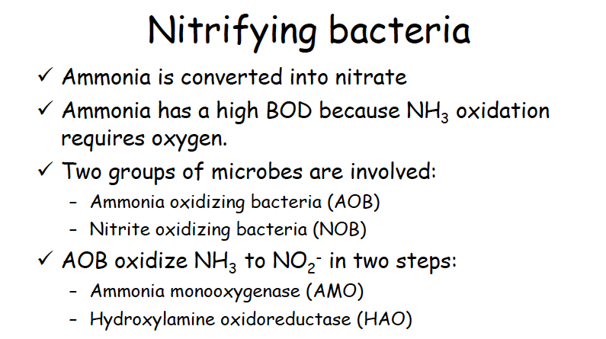
Both breathe oxygen

Slide 40
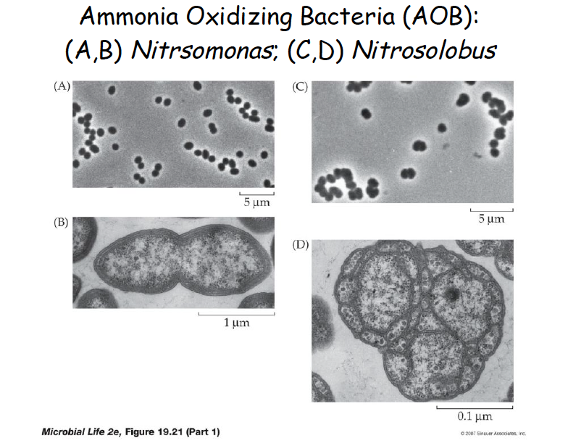
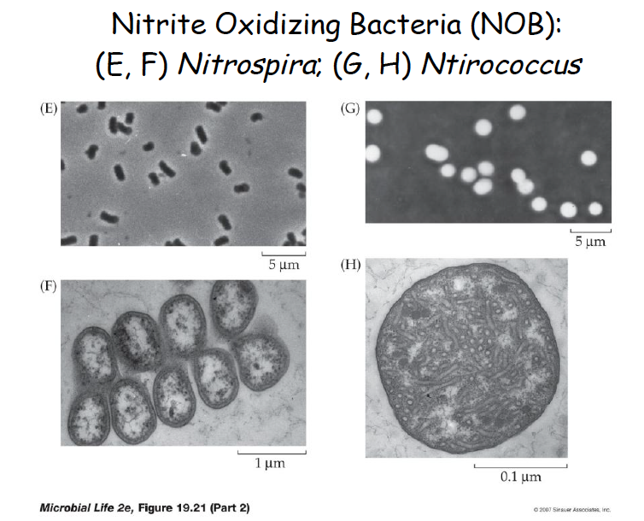
Nitrococcus

Slide 41
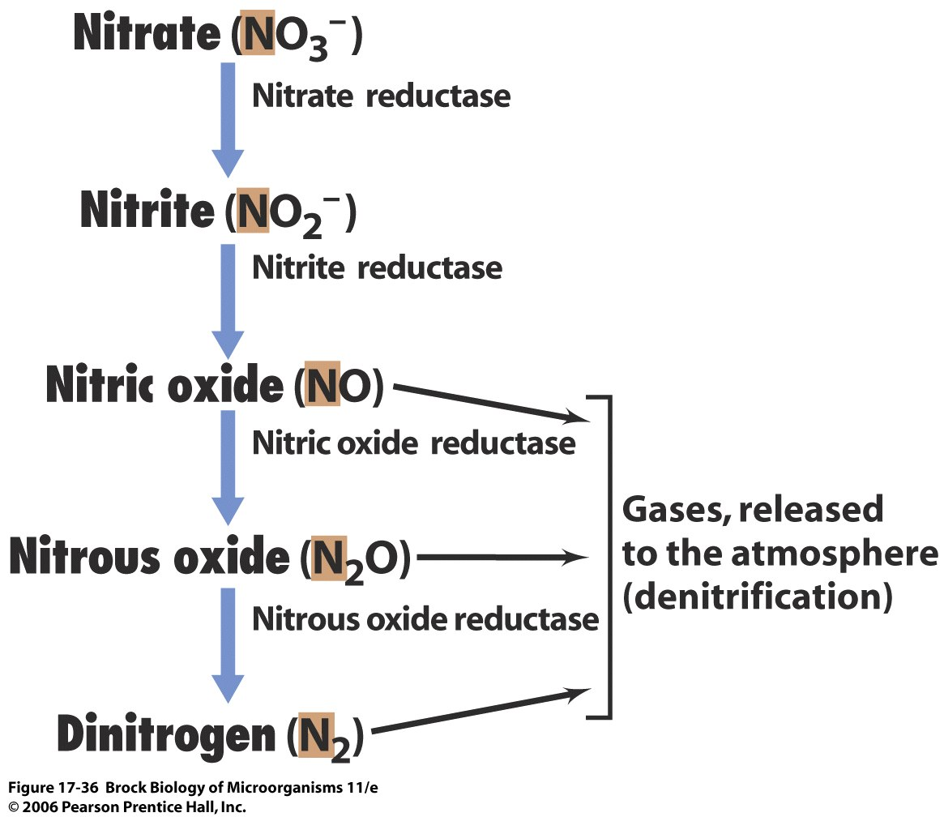
Denitrifiers (for instance Pseudomonas) then reduce nitrate to N₂

Slide 42
Nitrogen removal strategies
Nitrification/Denitrification
NH₃ + 2O₂ = NO₃⁻ + H⁺ + H₂O
NO₃⁻ + (5 e- + 6H⁺ )= ½ N₂ +3 H₂O
Partial nitrification/Anammox (= nitritation/anammox)
½ NH₃ + ¾ O₂ = ½ NO₂⁻ + ½ H⁺ + ½ H₂O
½ NH₃ + ½NO₂⁻ + ½ H⁺= ½ N₂ + H₂O

Slide 43
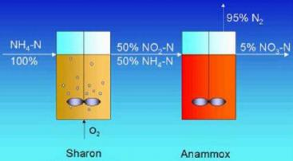
Nitritation/Anammox

Slide 44
Phosphorus removal also very important!
Preventing eutrophication (for instance can cause algal blooms)
Recovery/reuse
Global phosphorus reserves are limited
Large amounts lost in human, agricultural, industrial wastes
Notes:
remains is of lower grade and more
difficult to access than ever before
Excessive inorganic phosphate (Pi) supply to freshwater negatively
affects water quality and ecosystem balance through a process known
as eutrophication1. Limitations on allowable Pi discharges from
municipal and industrial sources through wastewater treatment have
proven effective in reducing Pi levels in many waterways2. Increasingly
stringent Pi limits for effluent wastewater are expected in the future
and hence efficient and reliable Pi removal methods are required.
Because of the massive quantity of wastewater treated daily (more
than 120 billion liters in the US alone3), any improvement in existing
methods should have tangible economic and ecological consequences.

Slide 45
Enhanced biological phosphorus removal (EBPR)
Produces effluent containing low levels of phosphorus
Enables concentration of phosphorus 10-50X
Relies on a specific group of bacteria, collectively called polyphosphate accumulating organisms (PAOs)
Phosphorus stored by PAOs as intracellular granules of polyphosphate
For use, polyphosphates can be solubilized or sludge can be applied directly
Notes:
to take up phosphate
from wastewater in excess of their growth requirements,
under alternating anaerobic and aerobic/anoxic conditions
enables concentration of phosphorus
by 10– 50 times. The process produces a solids stream
(called sludge in wastewater literature) that is rich in
phosphorus. This stream contains phosphorus at 5– 7%
[13 ], and is suitable for phosphorus recovery.

Slide 46
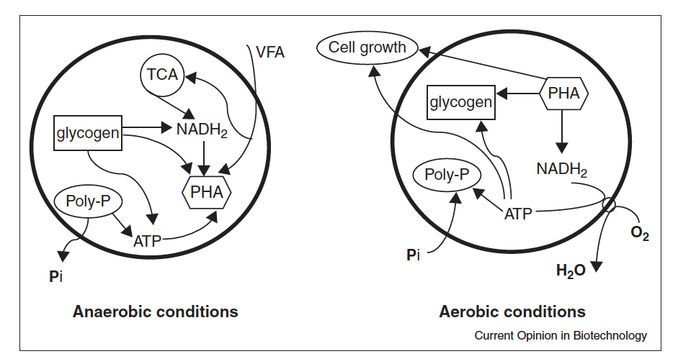
PHA=
polyhydroxyalkanoate
EBPR requires alternating anaerobic and aerobic conditions
Three intracellular polymers are central to the PAO metabolism
PAOs have growth advantage in anaerobic conditions due to ability to hydrolyze polyphosphate
Under aerobic conditions, PHAs stored anaerobically are oxidized to produce energy
Amount of phosphate taken up exceeds that released
Current Opinion in Biotechnology 2012, 23:878–883
Notes:
The hydrolysis of polyphosphate enables PAOs to gain
energy under anaerobic conditions, which is used to take
up organic carbon, primarily short-chain volatile fatty
acids (VFAs) [12]. This unique metabolism provides
PAOs advantages over most other organisms, which are
unable to use carbon sources anaerobically. The reducing
equivalents for the conversion of VFAs to PHAs is primarily
provided by the hydrolysis of glycogen, although the
oxidation of VFAs through the full or partial tricarboxylic
acid (TCA) cycle could also supply part of the reducing
equivalents, particularly when glycogen is limiting [18].
Under the subsequent aerobic conditions, PHAs stored
anaerobically are oxidized to produce energy for phosphate
uptake, glycogen replenishment and cell growth
[12]. Because the amount of phosphate taken up by PAOs
is in excess of that released anaerobically, a net accumulation
of phosphorus in biomass is achieved. Some PAOs
have been found to be able to use nitrate and nitrite in
place of oxygen as the electron acceptor for PHA oxidation

Slide 47
Who are the PAOs?
‘Candidatus Accumulibacter phosphatis’ (Accumulibacter) seems to be a dominant organism
Gram-positive Tetrasphaera-related organisms (Actinobacteria) also regarded as PAOs
Metabolic processes poorly understood, appear to differ from those of Accumulibacter
**No PAOs have been isolated in pure culture
Notes:
*stress that neither isolated so not very well understood.
The most well known group of PAOs is ‘Candidatus
Accumulibacter phosphatis’ (Accumulibacter). It belongs
to subclass 2 of Betaproteobacteria and is closely related to
Rhodocyclus [21]. Pure cultures of Accumulibacter are still
not available despite numerous attempts to isolate these
organisms. However, they have been frequently enriched
in laboratory-scale EBPR reactors [12], and have also
been found to be abundant in full-scale EBPR sludges
typically representing 5–20% of the bacterial community

Slide 48
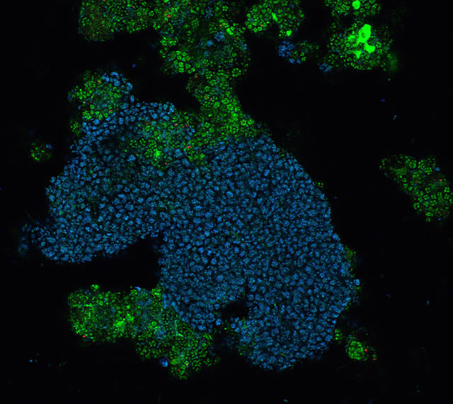
Fluorescence in situ hybridization (FISH) of a floc from an EBPR reactor. Accumulibacter specific probe in blue
Notes:
A FISH image of a floc from a lab-scale EBPR reactor and 400X magnification. The image was captured using a Zeiss LSM 510 confocal microscope with two channels: FITC and Cy5. The EUBmix probe (FITC) was used to stain all bacteria, which appear in green. The PAOmix probe (Cy5) was used to stain Candidatus Accumulibacter Phosphatis, which appear in blue

Slide 49
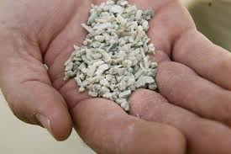
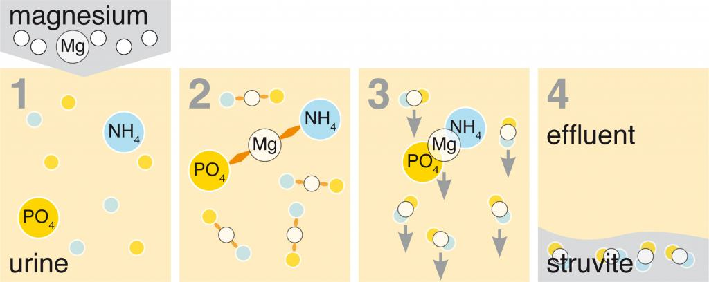
Fertilizer from Urine (or anaerobic Digester supernatant)
Struvite (ammonium magnesium phosphate) is a phosphate mineral with formula: NH₄MgPO₄·6H₂O.

Slide 50
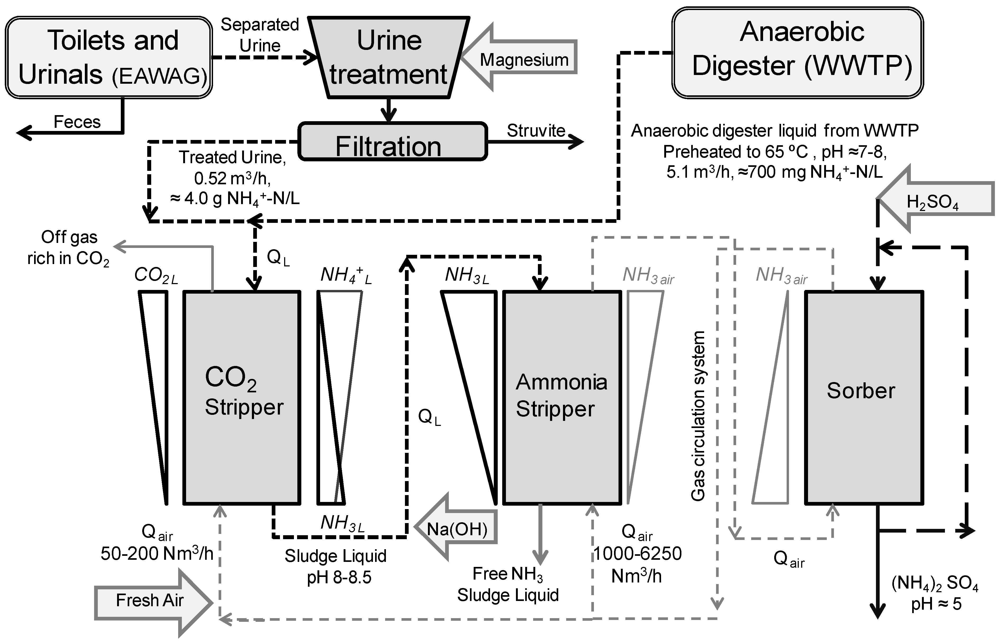
Nutrient (N & P) recovery from source- separated urine
Yellow-water:
separated urine
From: Water 2013, 5(3), doi:10.3390/w5031262

Slide 51
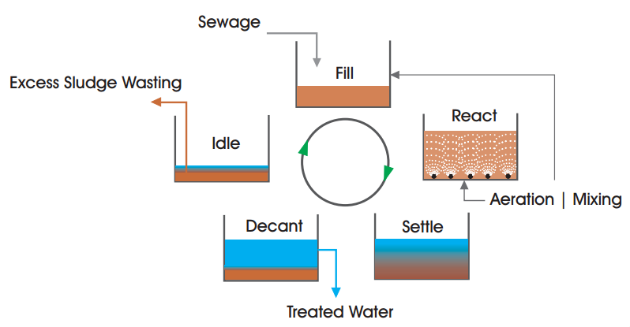
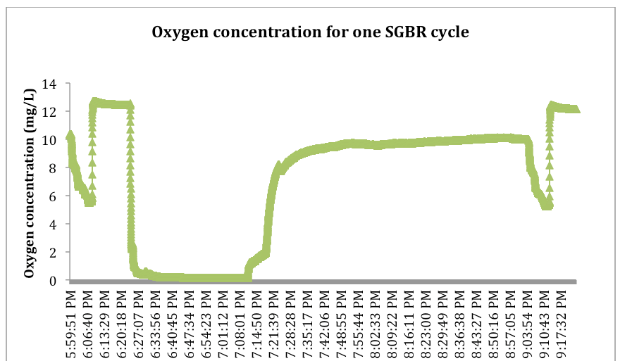
Granular Sequencing Batch Reactor (GSBR)
Fill/mix
drain
aerobic
settle
anaerobic

Slide 52
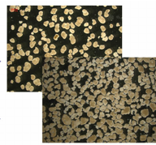
Granules
Enhanced Bio P Removal also occurs in these reactors (anaer/aero cycling)

Slide 53
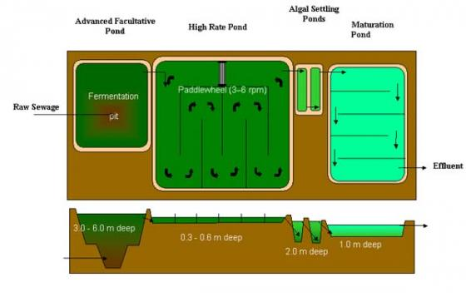
Algal ponds: for nutrient removal & algae production

Slide 54
Constructed wetland types for wastewater/graywater treatment
Microbial conversions in SF wetlands
Surface Flow
SF
Sub-surface Horizontal Flow
SSF

Slide 55
What about in the Global South??

Slide 56
Which technologies/approaches??
Systems and Technologies
User Interface
Collection
and Storage/ Treatment
Conveyance
(Semi-)
Centralised
Treatment
Use and/or
Disposal
Dry Toilet
Urine Diverting Dry Toilet
Urinal
Pour-Flush Toilet
Flush Toilet
Urine Diverting Flush Toilet
Single Pit
Single VIP
Dehydration Vaults
Septic Tank
Composting Chamber
Anaerobic Baffled Reactor
Anaerobic Filter
etc.
Human-Powered Emptying and Transport
Motorized Emptying and Transport
Simplified Sewers
Small-Bore Sewer
Conventional Gravity Sewer
Jerry Can/Tank
etc.
Anaerobic Baffled Reactor
Anaerobic Filter
Upflow Anaerobic Sludge Blanket
Trickling Filter
Waste Stabilisation Ponds
Activated Sludge
Constructed Wetland
Co-composting
etc.
Application of Urine
Application of Dehydr. Faeces
Compost
Irrigation
Aquaculture
Soak Pit
Leach Field
Land Application
Surface Disposal
etc.
Only selected combinations of technologies will lead to functional systems.
Notes:
Key messages:
Only selected combinations of technologies will lead to functional systems.
The most site-specific system option has to be selected on a case-to-case basis.
Note: in some systems, not all processes are required. Eg. When composting faeces locally, no conveyance nor central treatment is required.
Next slide: How can sanitation systems be classified?
Additional information & questions:
A system is a set of technologies, each processing the products until they are ultimately disposed of. In other words, processing all the waste products “from cradle to grave” should be considered. As aforementioned, one can distinguish between eight mainly different treatment systems whose technologies can be logically linked to form an effective system.
Though the system templates (i.e. groups of processes and products) are predefined, the exact system and favoured technology still have to be selected from among the options provided. The choice is context-specific and should be made on the basis of the local environment, culture and resources. Despite the different technology options available, a comprehensive study of the specific situation is necessary prior to making the final decision.
Who should choose the technology options and based on what criteria?

Slide 57
SSWM.info section on water-nutrient cycle perspective
https://sswm.info/perspective/water-nutrient-cycle-perspective

Slide 58
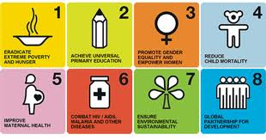
Sanitation crises worldwide
1 Billion people lack access to safe drinking water
3.6 Billion people lack access to sanitation for excreta
High capital and energy costs of industrialized waste treatment are prohibitive in non-industrialized locales
UN’s Millenium Development Goals’ call for

Slide 59
Objectives of Sustainable Sanitation
Health and hygiene
Effective barrier between user and environment
Prevention of exposure to excreta at all levels of the sanitation process
Environment and natural resources
Protection of natural resources
Recycling, low energy consumption, low emissions
Technology and operation
Adaptation to local circumstances
Robustness against floods, power cuts, water shortages, etc.
Financial & economic issues: Consideration of total (lifecycle) costs
Socio-cultural & institutional aspects: Acceptance by the community

Slide 60
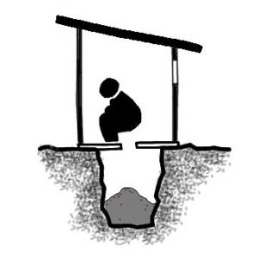
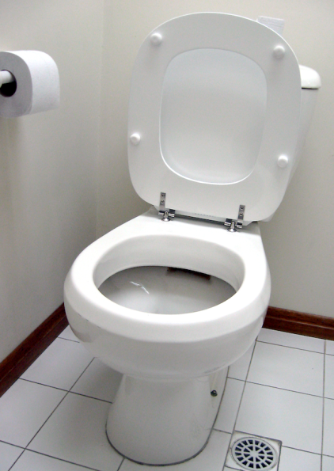
Conventional Forms of Wastewater Management and Sanitation
Dry (pit) systems (on-site)
Waterborne systems (centralised)
- Retention of solids
- Infiltration of liquids
Source: http://i.bnet.com/blogs/toilet.png [Accessed: 30.01.2012]

Slide 61
Sustainable Sanitation is a simple Approach
The essential principles
Wastewater and excreta should not be considered as a waste, but as valuable resources.
Sanitation systems should be organised in a socially acceptable and economically viable manner.
There is no “one-fits-all” approach, much rather, the most adequate solution has to be found from case to case, considering climate and water availability, agricultural practices, socio-cultural preferences, affordability, safety, and technical prerequisites, etc.

Slide 62
Promising technologies for international sanitation
Key features:
Decentralized (small scale) so communities take ownership/benefit
Low energy costs (ideally no Electricity-reliance)
Low water usage
Ideally, value added product (e.g fertilizer, natural beauty)

Slide 63
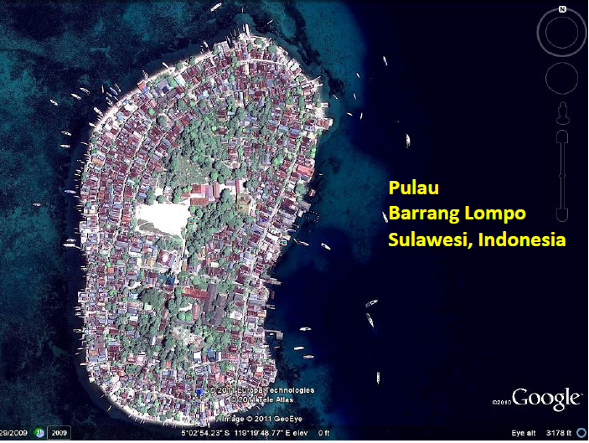
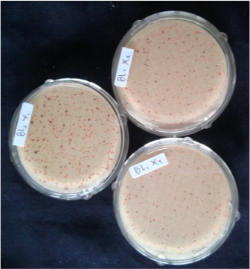
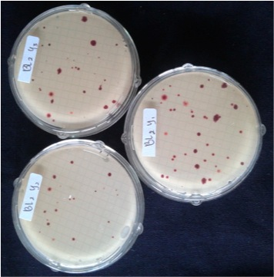
E.g. The Challenge for Small Islands in Indonesia
Fresh water is very limited
Coral reefs sensitive to waste
Agriculture: only bananas?
Energy: all imported (kerosene; electricity)
Most of population: use beaches as toilet

Slide 64
Example System: Waterless system with urine diversion
Systems and Technologies
User Interface
Collection and Storage/ Treatment
Conveyance
(Semi-) Centralised Treatment
Use and/or Disposal
Double Dehydration Vaults
Human Powered Emptying and Transport
Application of Treated Faeces to Crops
Faeces
Urine Diverting Dry Toilet & Urinal
Storage Tank
Jerry Can / Tank
Application of Urine
To Crops
Urine
Greywater Treatment
Irrigation of Crops
Greywater
Notes:
Key message/Figure:
Flow scheme illustrating waste processing in a dry sanitation system with urine separation and final application of all products.
Next slide: 2nd Example: Water-based alternating double pit
Additional information & questions:
The user interface(s) in this system generate(s) two different products: faeces and urine. Thus, each product must be treated separately with its own appropriate technologies and processes.
Faeces are stored in a double dehydration vault where they dehydrate. In the absence of moisture, organisms cannot grow and, thus, smells are minimised and pathogens destroyed. By using two vaults, the faeces are allowed to dehydrate and become sanitised, while allowing the system to remain in use.
Urine can either be collected in a bucket for later discharge on the ground or a garden, or it is stored in a tank for future transport. It is generally accepted that if urine is stored for at least one month, it will be safe for agricultural reuse.
Since a sanitation system must deal with all the generated waste products, an adequate reuse solution must also be found for greywater – an often forgotten resource. Greywater should not be added to the double dehydration vault where the faeces are being dried, nor should it be added to urine. In most cases, it is conveyed by drains or sewers and finally treated centrally, although many technologies exist for the beneficial use of greywater at the household level.
For both urine and faeces there is no technology option required at the ‘Treatment’ process step: the arrows indicate that after ‘Conveyance’, ‘Reuse and Disposal’ is the next process step required.
In this system, the different processing steps do not offer any technology choices. If the Compendium user does not like the technology options associated with this system, he/she should select a different system, since it is not possible to substitute or rearrange the technology options in a given system.
FOOTNOTE: Although greywater management is an essential part of sanitation, this Compendium is primarily concerned with systems and technologies related directly to excreta. For a more comprehensive summary of dedicated greywater technologies we refer you to the following resource: Morel A., Diener S. (2006). Greywater Management in Low and Middle-Income Countries, Review of different treatment systems for households or neighbourhoods. Swiss Federal Institute of Aquatic Science and Technology (Eawag). Duebendorf, Switzerland.

Slide 65






Distributed systems for Excreta or blackwater
Compost it:
(Aerobic treatment)
Digest to biogas:
(Anaerobic treatment)

Slide 66


Composting toilets

Slide 67
Learning Objectives, Wastewater treatment and Waste-to-Energy
Recognize the various embedded energy in domestic wastewater (heat, nutrients, and organic carbon) and that most of the COD, and nutrients come from excreta (urine and feces)
Describe the elements of a functioning centralized sanitation system (User Interface, conveyance, centralized treatment system, disposal and/or reuse of treatment products)
Recognize sanitation options that don’t rely on centralized treatment (e.g. composting toilets, urine diverting dehydrating toilets, septic systems, constructed wetlands, biogas reactors)
Sketch out a typical US wastewater treatment plant and recognize the two greatest electricity demands (aeration of activated sludge and pumps to move wastewater)
Recognize the key benefits of of anaerobic digestion of wastewater organic matter to “biogas” (sludge reduction, production of useable biofuel, opportunity for co-digestion of wastewater organics with local food industry wastes (e.g. brewery wastes, food scraps, manure, cheese and yogurt whey)
Describe the overall biological conversions and key microorganisms for the following emerging/advanced biological treatment reactors
UASBs, EBPR, Anammox, GSBR, MEC/MFC, Anaerobic membrane bioreactors (MBRs), algal ponds
Describe the following chemical treatment to recover nutrients from wastewater
Struvite precipitation and ammonia stripping

